Slide 1
WELCOME

Slide 2
Hospital Management System
Submitted To:
Md Mostofa Kamal Rasel
Assistant Professor,
Department of Computer Science and Engineering
Submitted By:
Sanat Kumar Mollick 2019-1-60-166
Maliha Mohasin 2019-1-60-171
Fatema Tuj Johora 2019-1-60-198

Slide 3
Description
Our project is about a Hospital Management System in which all of the data is stored in a single database. A Patient ID will be assigned to each patient. The patient's complete profile, including personal information and phone number, is followed by a description of the disease and the current treatment. Patients will be handled by the doctor, and one doctor can treat multiple patients. In addition, each doctor will be assigned a unique ID. There will be a connection between the doctor and the patients. Hospitalization is an option for patients. There will be distinct room numbers, as well as rooms for Operation Theaters and ICU. There are some nurses and ward boys who are responsible for the hospital's upkeep and patient care. A treatment bill will be created based on the number of days.

Slide 4
Entity Sets :
Hospital
Patient
Doctor
Nurse
Ward boy
Bill
Special site

Slide 5
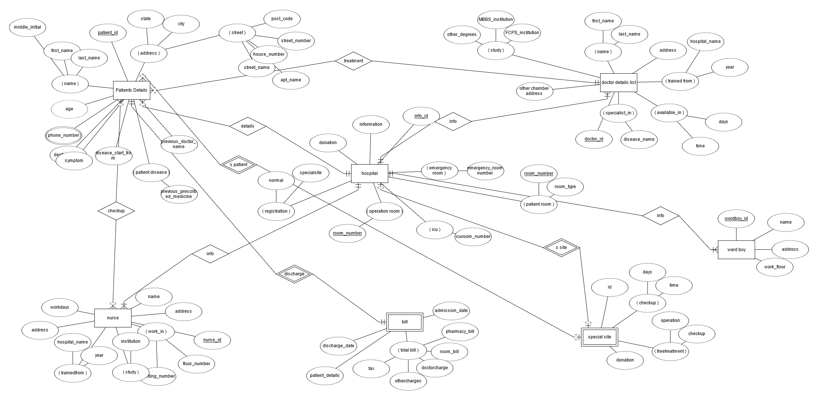
E-R Diagram

Slide 6
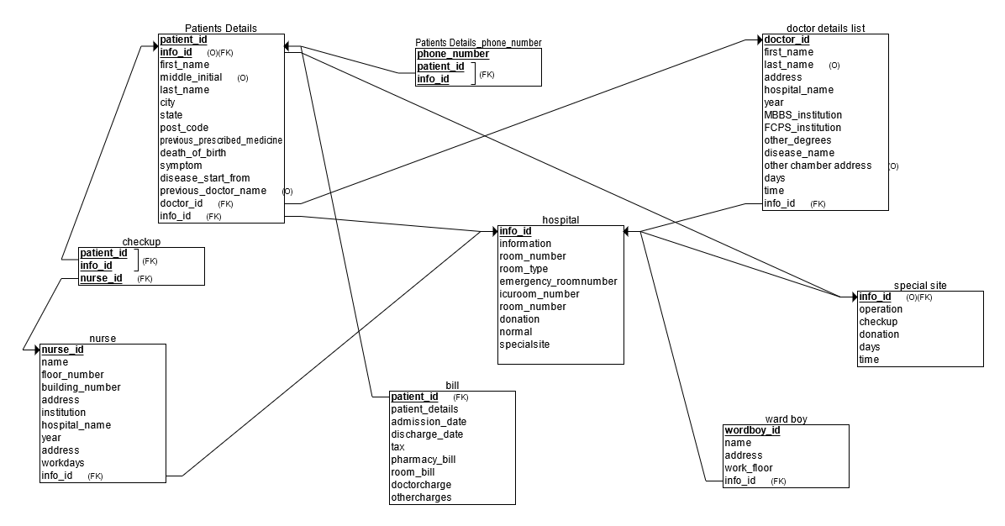
Relational Schema

Slide 7
Join Query
SELECT*
FROM patients_details AS p INNER JOIN doctor_details_list AS d
WHERE p.symptom = 'Liver Pain' and d.info_id = 500

Slide 8
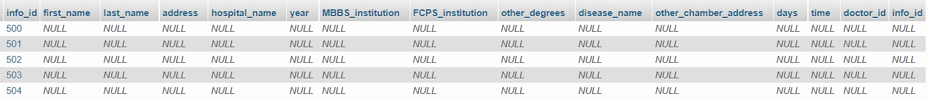
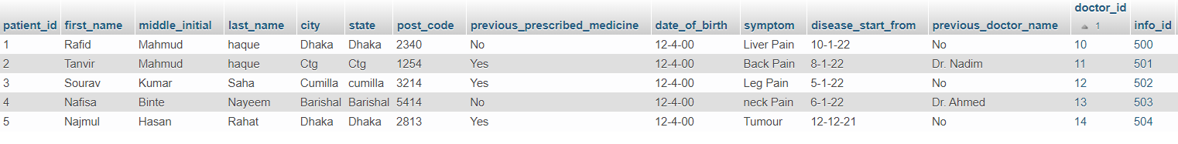
SELECT*
FROM patients_details as p
LEFT OUTER JOIN doctor_details_list d
ON p.patient_id = d.doctor_id
ORDER BY p.patient_id

Slide 9
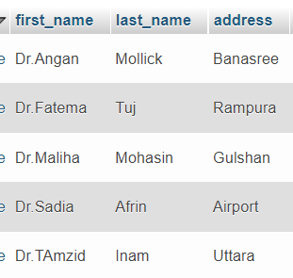
Update
UPDATE doctor_details_list
SET first_name = 'Dr.Skm’
WHERE first_name ='Dr.Angan’

Slide 10
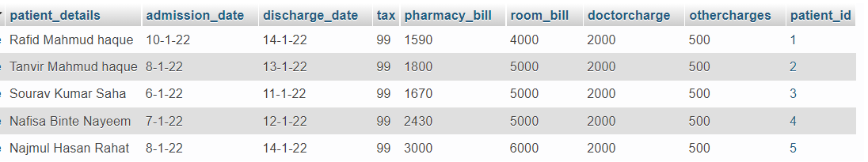
Delete
DELETE
FROM bill
WHERE patient_id = 1
Before delete:

Slide 11
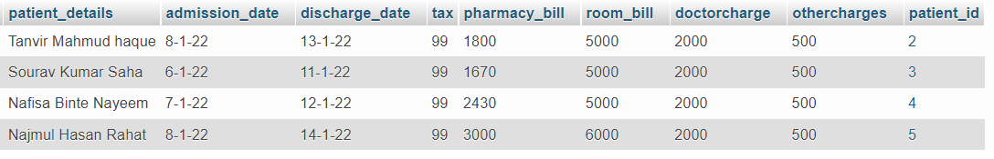
After delete :

Slide 12
Conclusion
Considering all of the above, we can deduce that the hospital management system is an unavoidable element of the modern medical institution's lifecycle. It streamlines user interactions by automating a variety of daily tasks. Developing hospital system software is a fantastic way to establish a unique, efficient, and quick healthcare delivery model. The implementation of a hospital management system project aids in the storage of all types of records, the provision of coordination and user communication, the implementation of policies, the improvement of day-to-day operations, the organization of supply chains, the management of financial and human resources, and the marketing of hospital services. This advantageous option meets the needs of patients, employees, and hospital authorities while also simplifying interactions between them. It has become the standard method of hospital administration.

Slide 13
THANK YOU

